Slide 1
Navigating Spectre & Meltdown Patching 1 Year later
Greg Bates
Lead Server Engineer
@pensrule82
WWW.vGregBates.com

Slide 2
Agenda
Who am I
Spectre\Meltdown memory lane
How do we patch it
VMware Mitigations
The Struggles
ForeShadow
How do we know we are mitigated
Lessons Learned
Poll
Beer talk

Slide 3


Who am I
Server Engineer @ Reed Smith LLP for 10 years
Entails Windows Server Lifecycle, VMware, Physical Server and Windows Patching
The examples in this presentation are an aggregate of multiple experiences. It is not necessarily specific to Reed Smith.
I am NOT a CPU architecture expert.
I am NOT an expert on cyber security.
I just play to part in meeting rooms.

Slide 4

Post traumatic Stress Trigger WARNING!
Memories of Patching Nightmares ahead.
The most complicated patching scenarios I have ever been apart of.

Slide 5
Remembering Melting & Spectre: The Beginning
Public Disclosure Jan 3, 2018
MS, RedHat and VMware release OS Patches
Intel Releases Microcode
OEM’s release Firmware

Slide 6

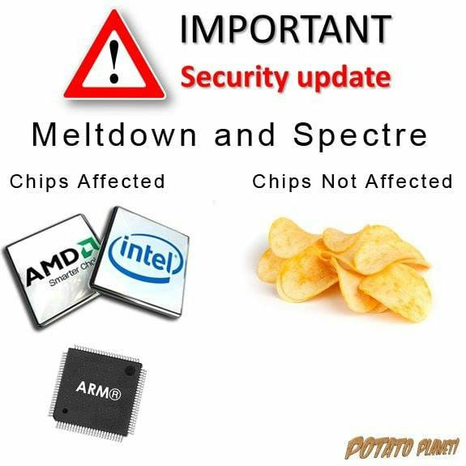


What’s affected

Slide 7
The Complexities
Microsoft
Microsoft Patch is dependent on Antivirus Patch
Microsoft requires additional Registry config to enable
VMware
VMware requires vCenter patch
VMware VM’s need Multistep process to enable
Hardware
OEM’s with their firmware bundles

Slide 8
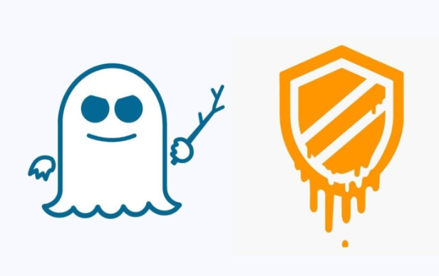

Cute Names and a Logo means its important.

Slide 9
The Confusion
Intel Microcode is Unstable
OEM’s Pull Firmware
Vendors pull patches

Slide 10
Act Together
Intel Releases Stable Microcode
Vendors follow suit
New vulnerabilities released, Spectre v3 & v4
More Microcode, OS patches required
L1 Terminal Fault (ForeShadow) Released
Repeat the Micocode and OS patches

Slide 11
CVE | Alias | Speculative Trigger | Mitigation
CVE-2017-5753 | Spectre v1 | Branch prediction bounds check bypass | OS\Browser
CVE-2017-5715 | Spectre v2 | Branch target injection | Microcode
CVE-2017-5754 | Meltdown | Out-of-order execution | OS
CVE-2018-3640 | Spectre v3a | System register read | Microcode
CVE-2018-3639 | Spectre 4 | Memory reads before prior memory write addresses known | Microcode\OS
CVE-2018-3665 | Lazy FP | Lazy FPU state restore | OS
CVE-2018-3615 | ForeShadow-SGX | Transient out-of-order execution | Microcode
CVE-2018-3620 | ForeShadow-OS | Transient out-of-order execution | Microcode\OS
CVE-2018-3646 | ForeShadow-VMM | Transient out-of-order execution | Microcode\OS

Slide 12
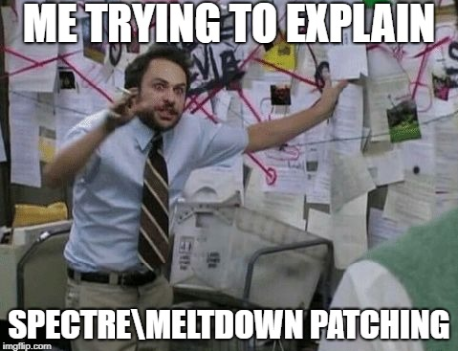
Patch or Upgrade Anti-virus
Patch Windows
Hold Breath
Enable Mitigation
Start
Microcode
vCenter
Panic Attack
Install Microcode Again
Upgrade VM
Oops Remove
Patch Hosts
Beer Thirty
Cold Boot VM
Complete CLUSTER
More Patches
Guests Mitigated
More Patches More Microcode
Maybe?

Slide 13
VMware Host Mitigation
vCenter
Patch vCenter
Prep
Confirm EVC Level of Clusters. If this is not set, vMotion will not work after the patching
Patch
Patch Hosts with Microcode and Security Updates
Complete
Complete ALL hosts in same cluster
Move on
Then Complete VM tasks

Slide 14
VMware Guest Mitigation
Confirm ALL the Hosts is in the cluster are patched.
Upgrade VM Version to at least version 9 or higher.
Version 11 or higher includes performance benefits.
Shut each VM off, then power back on. Cold restart

Slide 15
Early Struggles
The Dependencies
Explaining the complexity
Performance Concerns
Delayed Patches

Slide 16
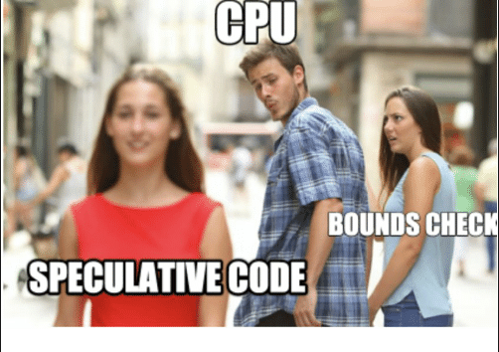
More Struggles
Buggy Firmware Upgrades.
Dependencies are important.
Takes a long time.

Slide 17
VMware Struggles
We had a mixed mode of vCenters.
vCenter 6 (Windows) and vCenter 6.5 (VCSA)
The mitigation and upgrade happened at same time.
It slowed both projects down.
vCenter bugs and “features.”

Slide 18
ForeShadow: L1 Terminal Fault
August 2018 Release
VMware vCenter, OS and Microcode patch required
Serious Performance Considerations
Enables ESXi Side-channel Aware Scheduler
(Disables HyperThreading)
VMware KB 56931
Run HTAware Mitigation Tool

Slide 19
How do you know if you are Mitigated?
Microsoft PowerShell
Install-Module Speculation Control
Get-SpeculationControlSettings
Vulnerability Scanners (Nexpose)
Community Scripts
vDocumentation : https://github.com/arielsanchezmora/vDocumentation
This Powershell module can actually list off the VM’s that are mitigated or not from VMware's perspective.
It also reports on the Hosts mitigation level and microcode level.

Slide 20

Lessons Learned
Don’t Panic
Take the time to explain the process to everyone
Do Research
TEST
Monitor the Community.
Reddit
Twitter

Slide 21
More Lessons Learned
Keep your equipment up to date
Not bleeding edge, but relatively up to date
Emergency patch = Less dependencies = Less pressure.
Don’t put it off because it is complicated.
Security maybe the most important part of IT.
Get it out of the way, learn in the process.

Slide 22
Thank God It’s Mitigated!
</SARCASM>

Slide 23
Time for a quick poll
Get your Phone Out!
PollEV.com
GregBates004

Slide 24
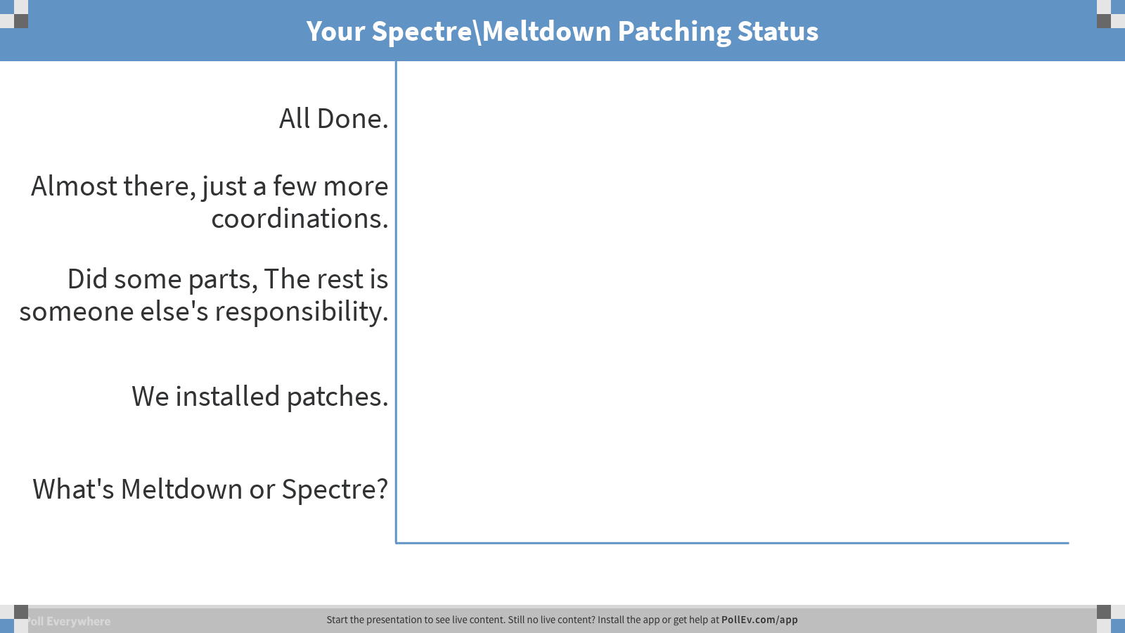
Notes:
Poll Title: Your Spectre\\Meltdown Patching Status https://www.polleverywhere.com/multiple_choice_polls/if6ykqsq3n6xZz0pVWpyN

Slide 25
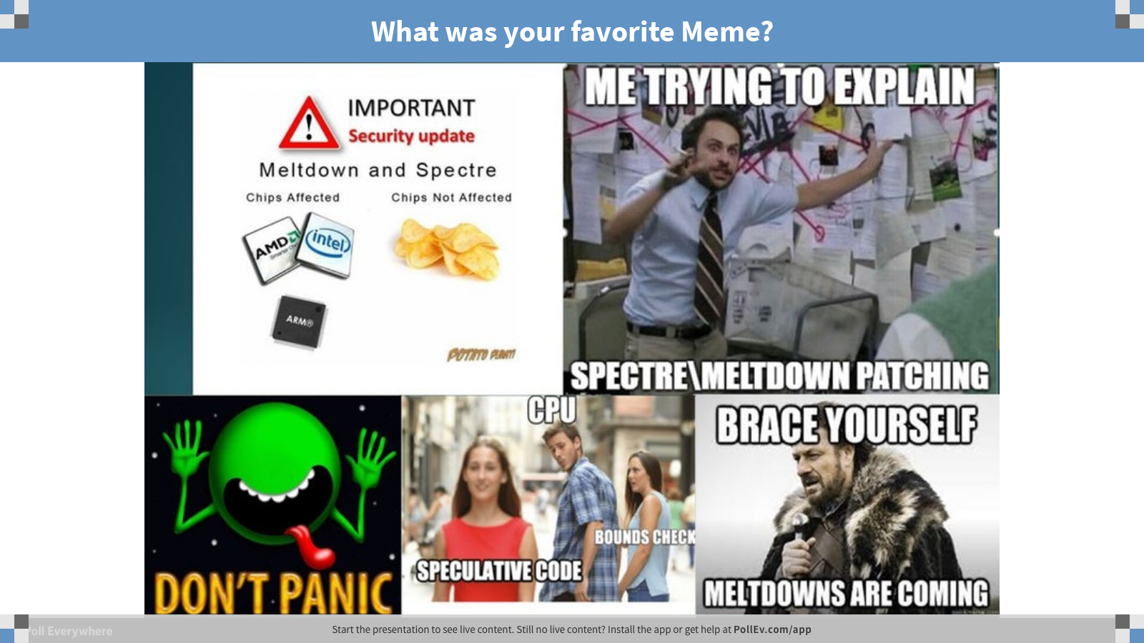
Notes:
Poll Title: What was your favorite Meme? https://www.polleverywhere.com/clickable_images/GweS38qR2psV8s3S3TkrS

Slide 26
The End
See me afterwards to talk patching war stories armed with a beer.
Greg Bates
@pensrule82
www.vGregBates.com

